Slide 1

Wrapping Up Well
6:21 – 24
Week 30
28 September 2022

Slide 2

Ephesians ch6 overview
As in all his letters, Paul wraps up the message to the Ephesians with some personal greetings and an encouraging farewell. Though some would be tempted to rush through the last few verses as a “throwaway” postlude with no doctrinal or practical meat, don’t do it!
Remember that “all Scripture is inspired by God and profitable for teaching, for reproof, for correction, for training in righteousness; so that the man of God may be adequate, equipped for every good work” (2Tim 3:16-17).

Slide 3
Ephesians ch6 overview
By the time we finish these final four verses of Paul’s powerful letter, we will have explored some essential principles of Christian life and ministry we cannot do without. They center on a somewhat obscure—but by no means irrelevant—ministry companion, the beloved and faithful Tychicus.
So, let’s see how well Paul wraps up, leaving us with a message of grace, truth, and love.

Slide 4
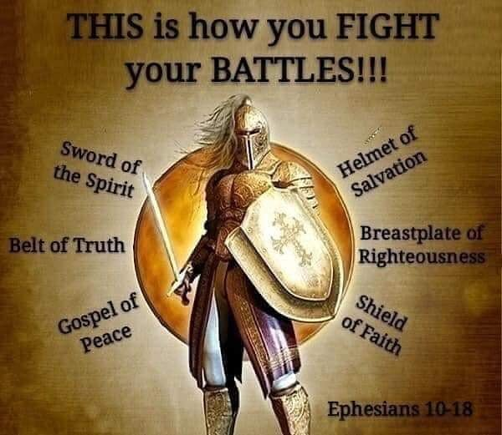

Slide 5

“Wrapping Up Well”

Slide 6
Ephesians 6:21 – 22
²¹Tychicus, the dear brother and faithful servant in the Lord, will tell you everything, so that you also may know how I am and what I am doing. ²²I am sending him to you for this very purpose, that you may know how we are, and that he may encourage you.

Slide 7
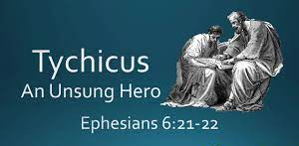

Slide 8
Ephesians 6:21 – 22
Tychicus first appears on the pages of Holy Scripture in Acts 20:4. Immediately after a riot in Ephesus (Acts 19:23-41), Paul departed to Macedonia, continued on to Greece, then returned to Macedonia (Acts 20:1-3). At this point Luke lists the men who were part of Paul’s ministry team, some joining the group in the several months that followed.
In any case, by the time Paul and his ministry partners arrived in Troas on the NW shore of Asia Minor, the following men were among Paul’s associates: three from Macedonia—Sopater, Aristarchus, and Secundus; four from Asia Minor—Gaius, Timothy, Tychicus, and Trophimus; and Luke, the physician and author of the Gospel of Luke and the book of Acts.

Slide 9
Ephesians 6:21 – 22
We can’t be sure if Tychicus was present with Paul throughout the remainder of his journey to Rome. But we know from Ephesians 6:21-22 and Colossians 4:7-8 that Tychicus was present with Paul in Rome at the time these letters were written. Tychicus served as the courier for both letters, as well as Paul’s personal representative to the churches in Ephesus and Colossae.
Thus Paul’s mention of Tychicus in Ephesians 6:21-22 is much more than simply a way to wrap up a letter. In fact, it gives us two important insights into a proper approach to ministry.

Slide 10
Ephesians 6:21 – 22
First, we must never forget that Paul engaged in a team ministry. Take the time to read the end of several of his letters to see how many friends he had working with him. In fact, we have no evidence that Paul was truly alone in ministry even during his imprisonments. He had faithful men and women like Tychicus, Timothy, Luke, Mark, Aquila, Priscilla, and Phoebe partnering with him.
Sometimes they would stay behind to strengthen the new churches planted by the apostle (Acts 17:14; Titus 1:5). Other times Paul would send them back to churches or send them ahead to a city to prepare for his upcoming visit (Acts 20:5; 1Cor 4:17). Many times they served as his messengers, carrying his precious and treasured letters to their destinations (Eph 6:21-22; Col 4:7-8).

Slide 11
Ephesians 6:21 – 22
Second, Paul valued personal presence as much as powerful and accurate proclamation. As both a “beloved” and “faithful” associate (6:21), Tychicus would often add a personal touch to Paul’s correspondence with the Ephesians. He would tell them how well Paul was holding up under his arrest and how the saving word of the gospel was spreading even further through Paul’s imprisonment.
Tychicus was able to respond to questions, hear and see the genuine concern in the Ephesians’ voices and faces, and mediate their thoughts and feelings back to Paul in a tangible way. We shouldn’t forget that the apostle preferred personal, physical presence among the people to correspondence.

Slide 12
Ephesians 6:21 – 22
In the conclusion of his third letter, the apostle John wrote > “I had many things to write, but I do not wish to write to you with pen and ink; 14 but I hope to see you shortly, and we shall speak face to face” (3 John 1:13-14).
In our techno-crazed world, in which we can carry on virtual “face-to-face” conversations over the Internet, take university courses and earn degrees without setting foot in a real classroom, and get powerful Bible teaching and preaching 24/7 at the touch of a button, we too quickly forget the need for flesh-and-blood presence. Nothing can ever take the place of a real person spending real time and sharing real space with other real people.

Slide 13
Ephesians 6:21 – 22
Paul did not just send Tychicus to Ephesus to share information that could have been accomplished through a letter. Rather, Tychicus was to share his very self, something that would comfort the hearts of the Ephesian believers (6:22).
This ministry of personal presence is exactly how God Himself works in our lives. Think about it: If information were all we needed, God could have just left us with the Bible, a book filled with inspired, inerrant, infallible information and reliable answers. The Bible is essential for our spiritual growth and health, and we would be lost without it. Yet to leave us only the written Word of God would have been to leave us as “orphans.” Without the revelation of Jesus Christ and the presence of the Holy Spirit

Slide 14
Ephesians 6:21 – 22
Without the revelation of Jesus Christ and the presence of the Holy Spirit, we wouldn’t be able to make heads or tails of the Bible, nor would we be able to apply it to our lives.
God desires to dwell with us, among us, even within us. The Bible is a means to that end: a personal relationship of “God with us.” The Son of God—Himself truly God—”became flesh, and dwelt among us” (John 1:14). People heard Him speak, saw Him with their eyes, and touched Him with their hands—the very “Word of Life” (1John 1:1).
Then when Christ ascended to heaven, He deliberately chose not to leave us alone. His personal presence is mediated to us through the Spirit of God—Himself truly God—who has come to indwell believers (John 16:7).

Slide 15
Ephesians 6:21 – 22
The practical implications of the principles of team ministry and personal presence are significant . First, those who are tempted to “go it alone” in ministry or the Christian life need to stand against that temptation.
God has designed us to live in harmony and to grow in community—to refresh others and to be refreshed, to encourage others and to be encouraged, to care for others and to be cared for by others, to give empathy and to receive it, to love and to be loved, to be accountable, affectionate, vulnerable, and sociable.
Furthermore, there is strength in numbers. We need each other desperately.

Slide 16
Ephesians 6:21 – 22
Second, those of us addicted to forms of communication that prevent personal presence need to strip away some of these barriers to true incarnational ministry. It might be time to turn off your cell phone, close your laptop, stop staring at your iPad, log off of your social network, and start investing real time with real people.
Represent Christ to others. Share the presence of the Holy Spirit as He encourages others through you. Invite others into your private world. Someday, as the shades of your earthly life begin to draw closed, you’ll be glad you did.

Slide 17
Ephesians 6:23 – 24
²³Peace to the brothers and sisters, and love with faith from God the Father and the Lord Jesus Christ. ²⁴Grace to all who love our Lord Jesus Christ with an undying love.

Slide 18
Ephesians 6:23 – 24
As Paul beautifully began his letter, so he eloquently closes it. He extends a blessing of peace, love, and faith from God the Father and the Lord Jesus (6:23). It’s almost as though Paul were summing up the main themes of the entire letter to the Ephesians.
Since Christ has established peace with God and between believers (2:14-15), those called by His name are to live out that peace, “being diligent to preserve the unity of the Spirit in the bond of peace” (4:3).
This peaceful way of life was first on Paul’s mind, and close behind it was love—the basis for achieving peace.

Slide 19
Ephesians 6:23 – 24
Knowing that all the doctrinal precision in the world meant nothing without love for Christ and for each other (1Cor 13:1-3), Paul repeatedly urged his readers to have an incorruptible love of Jesus Christ and a faithful love of the brethren (6:23-24).
How many times had Paul reminded the Ephesians of God’s love for them and their love for others? Interestingly, Paul uses the noun for “love” (agape) ten times in Ephesians. In fact, Ephesians averages more references to love per chapter than any of Paul’s other writings.
Given this strong emphasis on love, it’s sadly ironic that the church in Ephesus seems to have passed down everything to the next generation but that all-important fruit of the Spirit: “LOVE.”

Slide 20
Ephesians 6:23 – 24
About thirty-five years later, Christ Himself, through the apostle John, had this to say to the church at Ephesus > “But I have this against you, that you have left your first love. Therefore remember from where you have fallen, and repent and do the deeds you did at first” (Rev 2:4-5).
What a valuable lesson to learn from the Ephesians! Let’s remember to stand firm in doctrinal truth without losing our love for God, our love for fellow believers, and our love for the lost.
Because we have received new life through Jesus Christ by grace through faith alone, let’s live out that new life of love by the power of the Holy Spirit. When we yield to His transforming grace, we can be assured that the Spirit will do everything necessary to help us wrap up well.

Slide 21
Ephesians 6:23 – 24
Then we will be able to say the same words Paul said when he wrote his final words to Timothy, who was by then the Pastor of the great church at Ephesus > “I have fought a good fight, I have finished my course, I have kept the faith. ⁸Henceforth there is laid up for me a crown of righteousness, which the Lord, the righteous judge, shall give me at that day: and not to me only, but unto all them also that love his appearing” (2Tim 4:7-8).

Slide 22
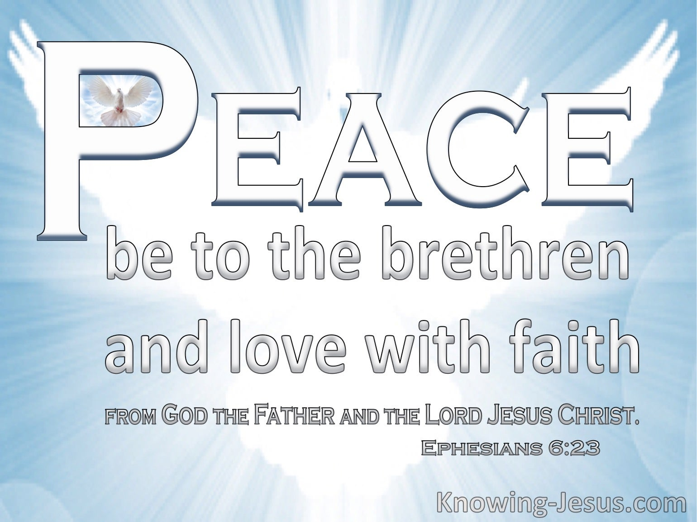

Slide 23
Wrapping up well
Being both profoundly theological and practical, Paul’s letter to the Ephesians strikes at the heart of the Christian life. The first half (Eph. 1 – 3) emphasizes our new position in Christ—forgiven and justified by grace through faith. The second half (Eph. 4 – 6) puts these truths into practice, emphasizing love and good works.
This simple structure clarifies the relationship between faith and practice, between description and prescription, between a firm footing in doctrine and practical steps of faith. If right doctrine and right practice were two guardrails along a straight road, few Christians would stay in the center of their spiritual journey very long before they drifted toward one extreme or another, throwing sparks and causing all kinds of damage.

Slide 24
Wrapping up well
As we wrap up our study of this doctrinally rich and practically enriching letter, ask yourself: Where do you find yourself on this road? There are four basic possibilities:
1] Puffed up by data – 1Corinthians 8:1 > “Knowledge puffs up, but charity edifies.”
Perhaps you spend your time, energy, and resources acquiring biblical theological, and historical knowledge. You have a regimented devotional time that looks more like preparing for an exam than spending intimate moments with the personal God you love. At the same time you have few outlets for actually expressing your faith—except, perhaps, those occasions when you teach, discuss, argue, or debate doctrine. If this describes you, then meditate on Eccl. 12:12; 1Cor. 8:1-3 and James 1:22-25.

Slide 25
Wrapping up well
2] Zeal without knowledge – 2Timothy 2:15 > “Study to show thyself approved unto God, a workman that needs not to be ashamed, rightly dividing the word of truth.”
Maybe you drift toward the other extreme. You stand against intellectualizing the faith and avoid structured learning in order to “experience” the faith. Perhaps the only kind of theology acceptable to you is “practical theology,” and you’d much rather learn from an uneducated pastor with years of real-life experience than a seminary professor who has spent most of his life with his nose in a book.

Slide 26
Wrapping up well
Your thirst for practical ministry keeps you engaged in the lives of the needy—but when it comes to responding to deep, profound questions about God, you don’t have a clue where to begin. If this describes you, then meditate on Ezra 7:10; 1Tim. 4:13; and 2Tim. 2:15.
3] Broken down or burned out – Hebrews 5:11 > “Of whom we have many things to say, and hard to be uttered, seeing ye are dull of hearing.”
Maybe you’re pursuing neither knowledge nor practical experience. Perhaps your mental, spiritual, emotional, and physical engines have finally sputtered to a stop, and you’re not advancing any longer in the Christian life.

Slide 27
Wrapping up well
Like those who grew “dull” in the letter to the Hebrews, you’ve stalled out on the road. By this time you should be well advanced in Christian doctrine and practice, but instead you need a fresh dose of baby food. If this describes you, then meditate on Gal. 6:9-10 and Heb. 5:11-14.
4] Clicking along at a good pace – 2Peter 1:8 > “For if these things be in you, and abound, they make you that ye shall neither be barren nor unfruitful in the knowledge of our Lord Jesus Christ.”
You may be at a fruitful and productive season in your walk with Christ in which you’re maintaining a healthy balance between biblical knowledge and practical application.

Slide 28
Wrapping up well
You’re exercising your gifts for the edification of the body of Christ and, in turn, you are being built up in the faith. You seek reconciliation when you sin, and you strive—by the power of the Holy Spirit—to seek the Lord in all you do. If this wholesome condition describes you, then meditate on 2Timothy 3:14-17; 2Peter 1:5:8; and Revelation 3:10-13.
The book of Ephesians as a whole reminds us that the Christian life is meant to be both believed and lived. This means we’re responsible for both doctrinal truth and practical living—everyday life lived in the light of meaningful theological truth.

Slide 29


Slide 30



Slide 31
NEXT CLASS – 5 October 2022
Book of Philippians
Before next class, read the below verses in the NIV and in one other versions of the Bible, i.e., NKJV, NRSV, KJV, CEV, etc …
Chapter 1:1 – 11
“Confident Enough to Be Joyful”

